Slide 1
Windows Administration
Telerik Software Academy
academy.telerik.com
Windows Security Model
Borislav Varadinov
System Administrator
bobi@itp.bg

Slide 2

Table of Contents
Accounts and Security Principals
Authentication and Authorization
Security Account Manager
Central Directory Service (Active Directory)
Security Identifier (SID)
Access Token
Security Descriptors and Access Control Lists
Logon Process
Sharing and Network Access
User Account Control (UAC)

Slide 3
Accounts and Security Principals

Slide 4
Accounts
What does mean Account?
Why we need accounts?
Everyday we use various services to do our job or to enjoy.
How we protect our accounts?
Usually we use username and password

Slide 5



Authentication and Authorization
Authentication refers to a process that verify who you are.
*****
Authorization refers to a process that verify what you are authorized to do.

Slide 6
Where is stored the accounts information in Windows?

Slide 7
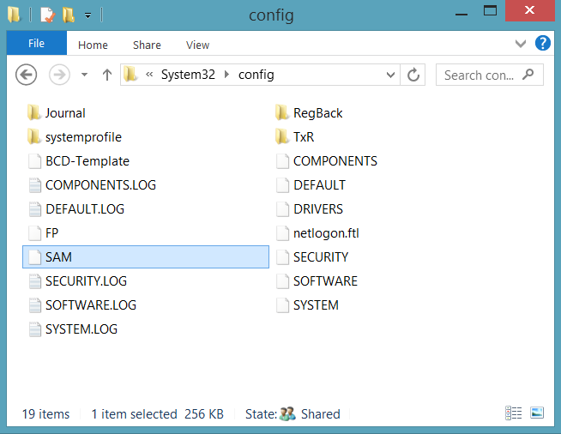
Security Account Manager
A registry hive that stores:
User accounts
Groups
Security information
Accessible only by system processes
Notes:
Accounts Manager (SAM) is a registry file
Stores users' passwords in a hashed format
When a user logs on to a computer using a local account, the SAM process (Samsrv) takes the logon information and performs a lookup against the SAM database, which resides in the windows system32/config directory(Something similar in UNIX, think etc/password). If credential match, then the user can log on to the system, assuming there are no other factors preventing logon, such as logon time restrictions or privilege issues.
Note that SAM does not perform the logon; that is the job of the LSA.
The SAM file is binary rather than text and passwords are stored using the MD4 hash algorithms.
On windows vista, the SAM stores password information using a password-based key derivation function (PBKCS).
In an attempt to improve the security of the SAM database against offline software cracking, Microsoft introduced the SYSKEY function in Windows NT 4.0. When SYSKEY is enabled, the on-disk copy of the SAM file is partially encrypted, so that the password hash values for all local accounts stored in the SAM are encrypted with a key (usually also referred to as the "SYSKEY").
In the case of online attacks, it is not possible to simply copy the SAM file to another location. The SAM file cannot be moved or copied while Windows is running, since the Windows kernel obtains and keeps an exclusive filesystem lock on the SAM file, and will not release that lock until the operating system has shut down or a blue screen exception has been thrown. However, the in-memory copy of the contents of the SAM can be dumped using various techniques, making the password hashes available for offline brute-force attack.

Slide 8




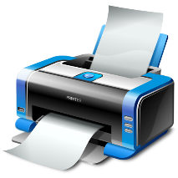



Central Directory Service
Stores accounts information in a central database
Organizes various objects into a hierarchical tree
Provides information for network resources
Enforces security polices
Policy
Policy
Notes:
A directory service used to store information about the network resources across a domain and also centralizes the network.
Server based authentication
Centrally managed
Its microsofts’s LDAP directory included with window server 2000 and later.
All client versions of windows, including windows XP and windows Vista, can communicate with AD to perform security operations including account logon
Windows client will authenticate using AD when the user logs on to the computer using a domain account rather than a local account.
Like the SAM scenario, the user’s credential information sent securely across the network, verified by AD, and then if the information is correct, the user can Logon.

Slide 9

Workgroup
User | Pass
John | P@sswOrd
Workgroup
User | Pass
John | 123456
SAM
SAM
Each computer has local SAM database
Suitable for small networks 2-10 computers

Slide 10
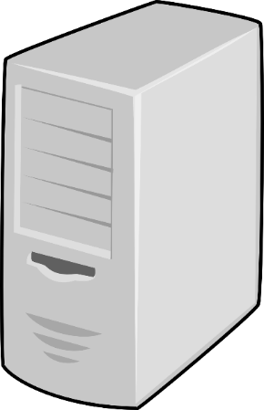
Domain
AD
User | Pass
John | P@sswOrd
Accounts are stored in a central database
More secure
More Scalable
Easy to manage

Slide 11
Security Principals
Entities that the windows security system recognizes
Foundation for controlling access to securable resources
Domain and Local
Domain
User Accounts
Computer Accounts
Groups
Well-known security principals
Local
User Accounts
Groups
Notes:
well-known security principals:
Everyone, Local System, Principal Self, Authenticated User, Creator Owner, and so on.
Security Reference Monitor (SRM)
Kernel Mode Component that
Performs Access Checks
Generates Audit Log Entries
Manipulates User Privileges

Slide 12
Security Identifier (SID)
Windows creates automatically a Security Identifier (SID) for each security principal
S-1-5-21-AAA-BBB-CCC-RRR
Security Identifiers are always unique
Windows uses Security Identifier to recognize you
You can think for SID as Personal ID Number (EGN)

Slide 13
Demonstration
Create
Local Users
Local Group
Manage
Local Users information
Group Membership

Slide 14
Access Tokens
Security Access Tokens

Slide 15
What is an Access Token?
An access token contains the security information for a logon session
The system creates an access token when a user logs on
Every process executed on behalf of the user has a copy of the token
The system uses the token to control access to securable objects

Slide 16
What information contains an Access Token?
User SID
Groups Membership SIDs
Privileges
System-wide permissions assigned to the logon user account
In Windows 2012, Microsoft introduced a new feature Dynamic Access Control which extends the access token with addition information

Slide 17
Demonstration
How to validate your access token
In order to update the information in your access token, you have to logoff and logon again.

Slide 18
Security Descriptors (SD)
and
Access Control Lists (ACL)

Slide 19
Security Descriptors
Security Descriptors are data structures of security information
Who is the owner of this object?
Who have access to read/write/etc?
Are the parent object rules included yes/no?
Some other information
Security Descriptors can be associated with different OS objects
File System objects
Registry objects

Slide 20
Access Control Lists (ACL)
The objects that require protection are associated with an ACL that includes:
SID of object owner
List of access control entries (ACEs)
Each ACE includes a SID and Access Mask
Access mask could include
Read, Write, Create, Delete, Modify, etc.
The Access Mask is different for each type of object (e.g. File, Printer, Registry etc.

Slide 21
Access Control Lists (ACL) (cont.)
Discretionary ACL
Grants or denies access to protected resources such as files, shared memory, etc.
System ACL
Used for auditing and to enforce mandatory integrity policy (Vista and later)
Notes:
An ACL is a list of permissions attached to an object
The list specifies who or what is allowed to access the object and what operations are allowed to be performed on the object.
Windows has two forms of access control list
Discretionary ACL (DACL):
Grants and denies access to protected resources in windows such as files, shared memory
System ACL (SACL)
Used for auditing and in windows vista used to enforce mandatory integrity policy
Objects that requires protection are assigned a DACL (and possible SACL), which includes SID of object owner as well as a list of access control entries (ACEs)
Each ACE includes a SID and an access mask
Access mask could include an ability to read, write, create, delete , modify and so on

Slide 22


Access Control Process
Group/User | Type
Managers | R/W
Company Users | Read
Administrators | Full
Group/User | Type
S-1-5-21-1085031214-1563985344-725345543-780 | R/W
S-1-5-21-1085031214-1563985344-725345543-639 | Read
S-1-5-21-1085031214-1563985344-725345543-500 | Full
Access Token
Bobi
Company Users
Administrators
Access Token
S-1-5-21-1085031214-1563985344-725345543-1131
S-1-5-21-1085031214-1563985344-725345543-639
S-1-5-21-1085031214-1563985344-725345543-500
Full
Access Token
S-1-5-21-1085031214-1563985344-725345543-1139
S-1-5-21-1085031214-1563985344-725345543-639
S-1-5-21-1085031214-1563985344-725345543-2184
Access Token
Secretary
Company Users
Office Assistants
File.docx
Read
Access Token
S-1-5-21-1085031214-1563985344-725345543-701
S-1-5-21-1085031214-1563985344-725345543-639
S-1-5-21-1085031214-1563985344-725345543-780
R/W
Access Token
Boss
Company Users
Managers

Slide 23
Demonstration
File System Permissions
Registry Permissions
Because of the object nature of Windows, ACLs can be associated with any object created by NT Object subsystem

Slide 24
Logon Process
Logon Process

Slide 25
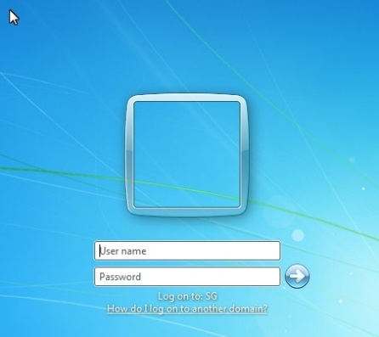

Logon Process
Interactive Logon (WinLogon)
Network Logon (NetLogon)

Slide 26
Log on
The interactive logon process is the first step in user authentication and authorization.
LSA Service
OR
SAM
Active Directory

Slide 27
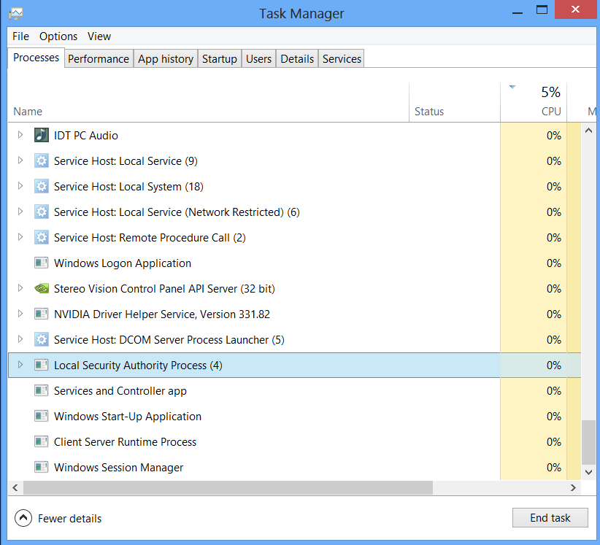
Local Security Authority (LSA)
Issues security access tokens to accounts
Responsible for enforcing local security policy
Lsass.exe
User mode
Key component of the logon process

Slide 28
Network Logon in Workgroup
User | Pass
John | P@sswOrd
User | Pass
John | 123456
Workgroup
SAM
SAM

Slide 29

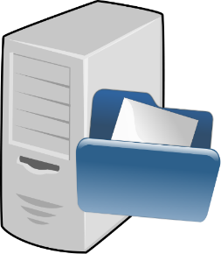

Network Logon in Domain
User | Pass
John | P@sswOrd
AD

Slide 30
Local Security Policy

Slide 31
Local Security Policy
Account Policies
Password Policy
Account Lockout Policy
Local Polices
Audit Policy
Users rights assignment
Security Options
Application Control Policies
Other (Firewall/EFS/IPSec)

Slide 32
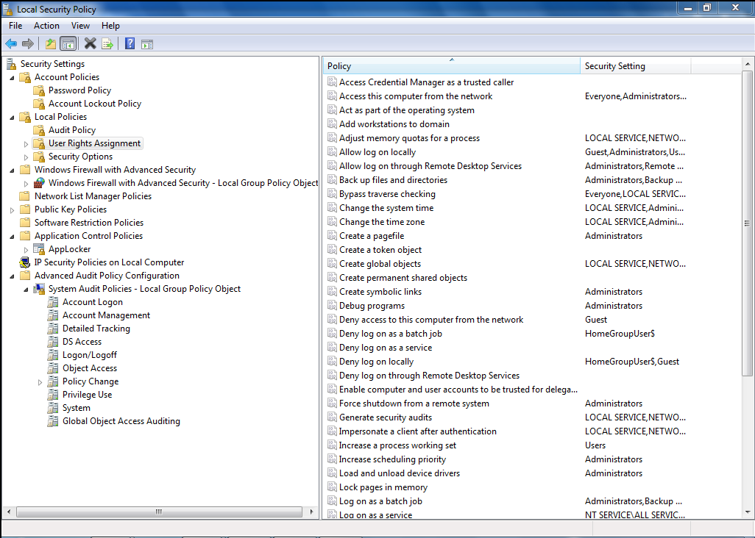
Local Security Policy (cont.)

Slide 33
Sharing and Network Access

Slide 34
Guest Account
Network logon with Guest Account
Deny access to this computer from the network
Notes:
Deny access to this computer from the network
This security setting determines which users are prevented from accessing a computer over the network. This policy setting supersedes the Access this computer from the network policy setting if a user account is subject to both policies.
Default: Guest

Slide 35
Advanced Sharing Settings
Turn on/off network discovery
Turn on/off file and print sharing
Turn on/off public folder sharing
Turn on/off password protected sharing
Remove Guest account from Deny access to this computer from the network
HomeGroups connections

Slide 36
Service Accounts

Slide 37
Service Accounts
Windows Services also runs from a context of account and also have access tokens
Local or Domain
Special Accounts
LocalSystem
LocalService
NetworkService

Slide 38
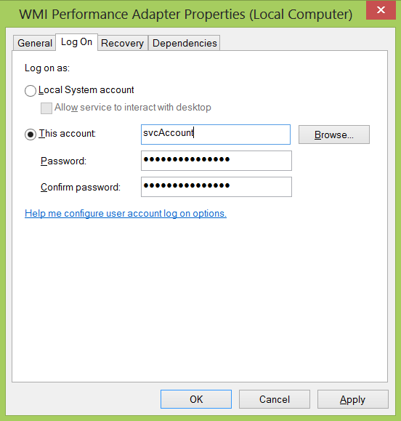
Log On Settings

Slide 39
User Account Control (UAC)

Slide 40
User Account Control
How it works: When your consent is required to complete a task, UAC will prompt you with a dialog box
Tasks that will trigger a UAC prompt include anything that will affect the integrity or security of the underlying system
This is a surprisingly long list of tasks
UAC works slightly differently with standard user and administrator-class accounts

Slide 41
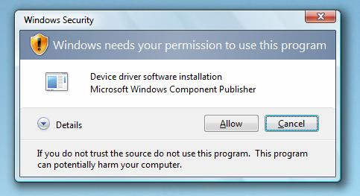
UAC Consent UI: Type 1
Prompt: Windows needs your permission to continue
Why you see this: You attempt to change a potentially dangerous system setting, such as a running a Control Panel

Slide 42
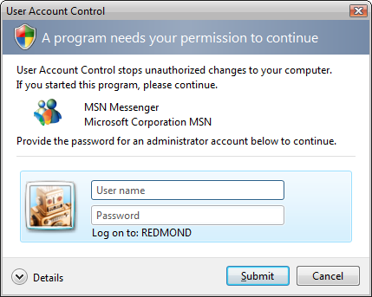
UAC Consent UI: Type 2
Prompt: A program needs your permission to continue
Why you see this: An external application with a valid digital signature is attempting to run with admin privileges

Slide 43
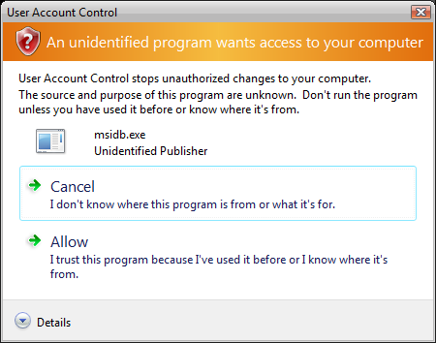
UAC Consent UI: Type 3
Prompt: An unidentified program wants access to your computer
Why you see this: in external application without a valid digital signature is trying to run

Slide 44
UAC: What’s really happening
Administrator accounts now logon with a mixed token
Half of this mixed token is a standard user token: this is what is typically used to determine your memberships and privileges
The other half, the administrator token, is invoked only when required: you can do so manually (run as) or automatically (certain tasks in OS are tagged as requiring an admin token)

Slide 45
Windows Security Model
http://academy.telerik.com

Slide 46




Free Trainings @ Telerik Academy
"Web Design with HTML 5, CSS 3 and JavaScript" course @ Telerik Academy
html5course.telerik.com
Telerik Software Academy
academy.telerik.com
Telerik Academy @ Facebook
facebook.com/TelerikAcademy
Telerik Software Academy Forums
forums.academy.telerik.com

